Slide 1
Art of Learning
People, Process, Technology
Modular, Iterative and Incremental
Vladimir POPOV

Slide 2
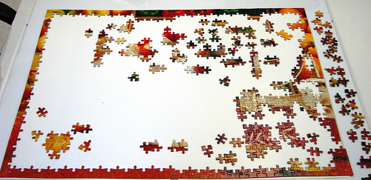
Our knowledge is an incomplete puzzle of skills
Our knowledge is a model of reality. The understanding is only as good and (in)complete as the model is.
More we learn, more we see what we don’t know yet, more we see the Big Picture.

Slide 3

Team up for success
Bring the pieces together.

Slide 4

Continue learning
Call for help, learn from experts, share the knowledge.

Slide 5
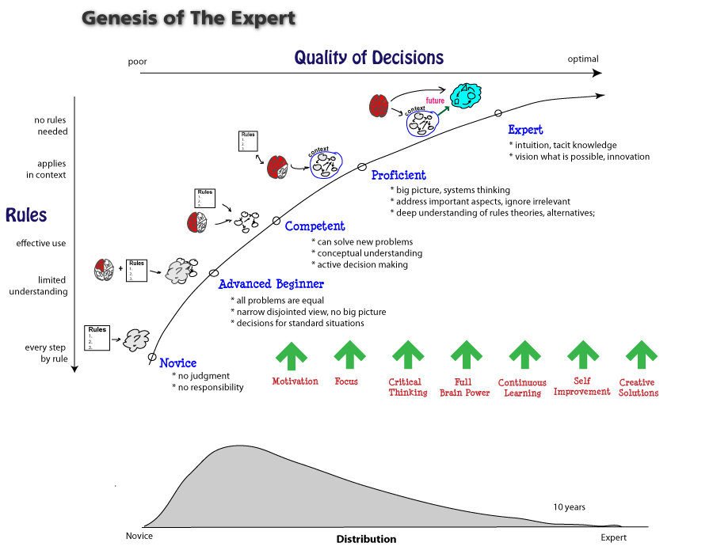
Skill Acquisition Model
http://www.leanleadershipacademy.com/lla-and-the-genesis-of-the-lean-expert/

Slide 6
Dreyfus skill aqcuisition model
 | Skill level acquired (professional, hobby, anything), not a person!
Novice (1.5+ m) | Every step by rule. Only feels responsible to follow the rules. No judgement. No responsibility.
Confirmed (6+ m) | Limited understanding. Still does not experience personal responsibility. All problems are equal. Narrow disjoint view. No big picture
Competent (1.5+ y) | Effective use. Sense of responsibility arises from actively making decisions. Can solve new problems. Conceptual understanding. Active decision making.
Proficient (4+ y) | Applies in context. Sense of responsibility extends with experience. Big picture, system thinking. Address important aspects, ignore irrelevant. Deep understanding of rules theories, alternatives
Expert (10+ y) | Beyond rules. Responsibility extends to others and environment. Intuition, tacit knowledge. Vision what is possible. Innovation.

Slide 7
Continue learning
Level | Rules->Vision | Capability->Quality of Decision
Expert (10+ y) | No rules needed | Intuition, tacit knowledge Vision what is possible Innovation
Proficient (4+ y) | Applies in context | Big picture, system thinking Address important aspects, ignore irrelevant Deep understanding of rules theories, alternatives
Competent (1.5+ y) | Effective use | Can solve new problems Conceptual understanding Active decision making
Advanced Beginner | Limited understanding | All problems are equal Narrow disjoint view No big picture
Beginner | Every step by rule | No judgement No responsibility

Slide 8
What Defines Seniority?
Passionate expert practitioners that actually care about the domain they are working in. They exchange their knowledge and ideas and they are more invested into why they developed things instead of how. They exceed the technical boundaries of their problems by far and are focused on business value. That defines a senior.
A senior developer is someone who challenges her employer and/or customer and questions his authority to gain a better understanding of the business and deliver what the customer truly needs. She knows and constantly learns about all the technicalities necessary to deliver quality result, but her main focus is on business value. She is not only able, but embraces to think out of the box, because that is where the magic happens.
Senior developers can be hundreds of times more productive on a business level than even the most proficient junior programmers.
http://www.heimeshoff.de/blog/2013/06/26/why-you-should-only-hire-senior-developers

Slide 9
Organization Maturity Model
Modularity is the key
3-9 month
0. Analysis Ability.
Decompose system input into basic measurable units.
1. End-to-End Traceability.
Implement system for capturing and monitoring measurements.
2. Stabilize System Metrics.
Inventory, Lead Time, Production Rate. Demonstrate basic statistical control – show the system is stable against a target and within a tolerance.
3. System Thinking, Learning Organization.
Focus on continuous improvement. New targets, lower inventory, shorter lead time, higher production rate. Identify constrains; exploit constraints; subordinate to decision; elevate constrain.
4. Anticipated ROI, Failure Tolerant Organization.
Encourage risk taking. Focus on Throughput (value), not production quantity. Focus on market research / feed back (i. e. external constrains and factors)
6-18 month
12-36 month
24-48+ month
Continuous

Slide 10
An opinion is a bias defeind by the skillset
An opinion (bias) is never right or wrong. It is only more profound or less complete. Or both.
Opinions (biases) change.
Quotes (biases):
“For every complex problem, there is a solution that is simple, neat, and wrong.”
- Henry Louis Mencken. American humorous journalist and critic who influenced US fiction through the 1920s, 1880-1956
“Things should be made as simple as possible, but not any simpler. “
- Albert Einstein. Physicist, Nobel Prize for Physics in 1921, 1879-1955.
“The Earth is flat.” - an approximation true within, let’s say, a parking lot.
“<insert a citation…>”
- <You>

Slide 11
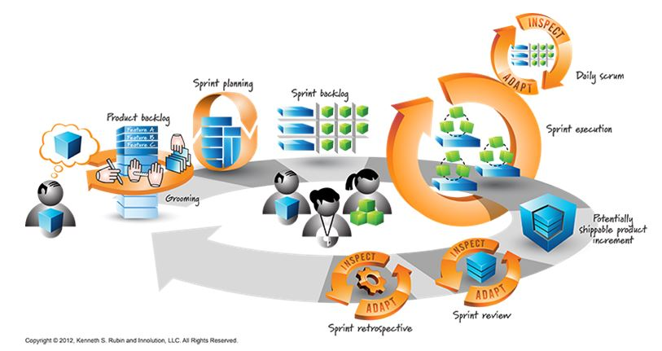
Modular system maps well into iterative process
Inspect and Adapt

Slide 12
Agile Manifesto
We are uncovering better ways of developing software by doing it and helping others do it. Through this work we have come to value:
Individuals and interactions over processes and tools Working software over comprehensive documentation Customer collaboration over contract negotiation Responding to change over following a plan
That is, while there is value in the items on the right, we value the items on the left more.
http://agilemanifesto.org/

